Slide 1
Equitech Growth Fund
Webinar II
We will begin shortly.
Grab a pen and notepad for note taking.

Slide 2
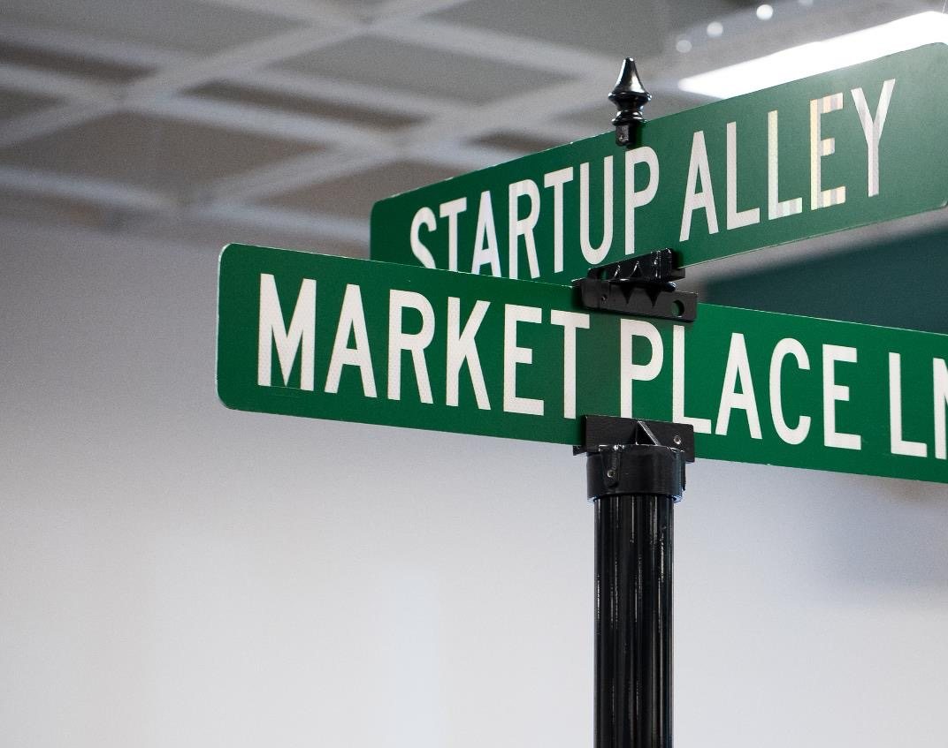
Leading Innovation to Market for 27 years
TEDCO’s Mission
Enhance economic empowerment by fostering an inclusive and entrepreneurial innovation ecosystem. Identify, invest in, and help grow technology and life science-based companies in Maryland.

Slide 3
Equitech Growth Fund: Background Context
Equitech Growth Commission
  Mission: established in 2023 by legislation (CH 461 of 2023) to develop a strategic plan that is inclusive, comprehensive, and reaches the 10–year goals for growing the State’s innovation economy. Identify mechanisms (priority industry areas) for increasing high-tech job growth and expanding wealth in underrepresented communities.
  Involves a broad selection of voices across Maryland State
  Final Strategic Plan is available for review
Notes:
The Commission convened and developed a preliminary funding plan for Round 1 of Equitech Growth Fund. The final version will be available toward the end of Q2.

Slide 4
Equitech Growth Fund: Overview
Equitech Growth Fund (CH 461 of 2023): supports the economic competitiveness and inclusive growth of emerging and advanced industries in the State. This is through the creation of a diverse workforce and supporting infrastructure assets.
Equitech Growth Commission developed priority industry areas in a Final Strategic Plan (June 2025). These technology industries produce positive job growth and wealth, particularly in underrepresented communities.
  Two tracks:
    Workforce Development – up to $250,000
    Infrastructure – up to $1,000,000
  Runs until FY2033, one round per year
    4 to 5 Million allocated per year
  Overall Target: 87,000 jobs created in priority industry areas
Notes:
The final piece of the puzzle is why all of you are likely on the call today – funding. This strategic investment executes on the vision Cultivate Maryland, the mission of Equitech Growth Commission’s strategic plan. As a funding vehicle, we hope to see a diverse array of projects awarded over the next 8 years. The target goal would be 87,000 jobs created in emerging and advanced industries. Priority given to jobs with high skill and middle skill occupation, with high-pay earning ceilings.

Slide 5
Equitech Growth Fund: Eligibility Criteria
Intend to have a physical presence in the State of Maryland for 5 years
Good Standing with the State of Maryland
Eligible formation structures are as follows:
  Public Entity
  Nonprofit Organization
  Private Entity
  Institutions of Higher Education
  Public-Private Partnership
  Source: TEDCO’s Equitech Growth Fund Request for Application
Notes:
A minimum of 5 years.
if company is headquartered elsewhere, we will also ask for Good Standing there too. COGS – at the time of the award and during the entirety of the funded project.

Slide 6
Equitech Growth Fund: Project Criteria
Project must be headquartered in Maryland & serve the state’s workforce
Preferred, not required 1:1 cash match from private, public & federal sources
Proposed project tracks:
  Workforce Development – educational programs, certifications, training & non-degree programs
    12 – 24 months
    Between 8 - 10 anticipated awards
  Infrastructure – building, expanding equipment, systems, resources & facilities
    12 – 36 months
    Between 1 – 3 anticipated awards
  Dual use project types will be considered
  Source: TEDCO’s Equitech Growth Fund Request for Application
Notes:
Preferred cash match – not required
Infrastructure Projects – focus on building physical infrastructure that supports innovative economy. Advanced manufacturing, laboratory, and advanced technology. Physical assets that accelerate innovation.
Workforce Development – creating or scaling programs, certifications or training programs that prepare iinviduals for short or long term job opportunities.

Slide 7
Equitech Growth Fund: Priority Areas & Additional Consideration
Advanced Manufacturing
Advanced Technology
AR/VR learning facilities & modules
Advanced Laboratory
Expansion of STEAM Education
Entrepreneur Development
Cybersecurity/ IT Industry Workforce Development
Environmental & Energy Technology
Smart Agriculture
Healthcare, Life Science & Bioinformatics
Autonomous Systems & Robotics
Financial Technology
Creative Industries & Digital Media
Logistics & Supply Chain Innovation

Slide 8
Equitech Growth Fund: Priority Areas
Advanced Manufacturing
  Biomanufacturing facilities
  Aerospace and Defense Manufacturing
  Other
Advanced Technology
  Quantum computing labs
  Upgrades/Implementation of Cyber/AI Risk Management Systems/Frameworks
  SCIF Facility construction/improvements/upgrades
  Computational Biology
  Position, Navigation, Timing
  Environment Sensing Technology
AR/VR learning facilities and modules

Slide 9
Equitech Growth Fund: Priority Areas
Advanced Laboratory
  Flexible, affordable, modern wet-lab space and equipment.
  Laboratories designed to test advancements in existing/new technologies
  Field-based testing implementation
Expansion of STEAM Education
  Development and expansion of STEAM Programs, K-12 and postsecondary education
  Educator Professional Development programs
  Expansion of work-based learning, lifetime learning and career opportunities
  Reskilling & upskilling of transitioning Federal Workforce, veterans and military spouses/families

Slide 10
Equitech Growth Fund: Priority Areas
Entrepreneur Development
  Non-traditional Incubators, Accelerators, Venture Studios related to manufacturing start-ups
  Entrepreneur education programs/academies aligned with priority industry areas
  Innovation Districts
  Ecosystem Lifecycle Support Infrastructure
  Prototype development, Product Development and Testing
Cybersecurity/ IT Industry Workforce Development
  Intermediary/Workforce Development Centers
  Cyber Ranges/Clinics
  High-Tech Sector Workforce Development Programming
  Other related infrastructure

Slide 11
Equitech Growth Fund: Additional Areas of Consideration
Environmental and Energy Technology
Smart Agriculture and Food Technology
Healthcare, Life Science and Bioinformatics
Autonomous Systems and Robotics
FinTech (Financial Technology)
Creative Industries and Digital Media
Logistics and Supply Chain Innovation

Slide 12
Equitech Growth Fund: Application Form
Organization Name
Organization Address
Organization State
Organization Zip Code
Organization County
Organization Type
Applicant Contact Name
Applicant Contact Phone
Applicant Contact Email address
Project Industry
Project Title
Project Type
Project Location Address
Project Location County
Number of Partnerships
Partnership Entities, Listed by Name
Project Summary (500 words maximum)
Total funding requested
Total matching funds committed
Project Proposal (5 pages)
  Project Description
  Diversity & Inclusion
  Alignment with EGF
  Metrics & Impact
  Budget & Justification
  Letter of commitment for cash match

Slide 13
Equitech Growth Fund: Closing Documents
Application Form
Project Proposal
Key milestone between funding tranche(s)
Key Metrics v. Budget
Letter of Commitment for Cash Matching Funds
Project Location Lease
Certificate of Good Standing for State of Maryland
Articles of Incorporation
Bylaws or Operating Agreement
Board Resolution for Signing Authority

Slide 14
Equitech Growth Fund: Applicant Data (FY'25-FY'26)
Total Funding Request (FY'25): $31,828,585
Total Funding Request (FY'26): $41,400,636
Notes:
Bar graph showing industry data
Applicant increase (25%) 74 to 93 applications
Top 5 – Advanced Manufacturing, Cybersecurity/IT, STEM Education, Entrepreneur Development, Environment & Healthcare
Total funding requests vs received

Slide 15
Equitech Growth Fund: Application Cycle
Awardees Announced
Fund Opens
Webinar II
Office Hour
Fund Closes
Selection Process
April 3
June 11
July 23
August 7
September
October 2026

Slide 16
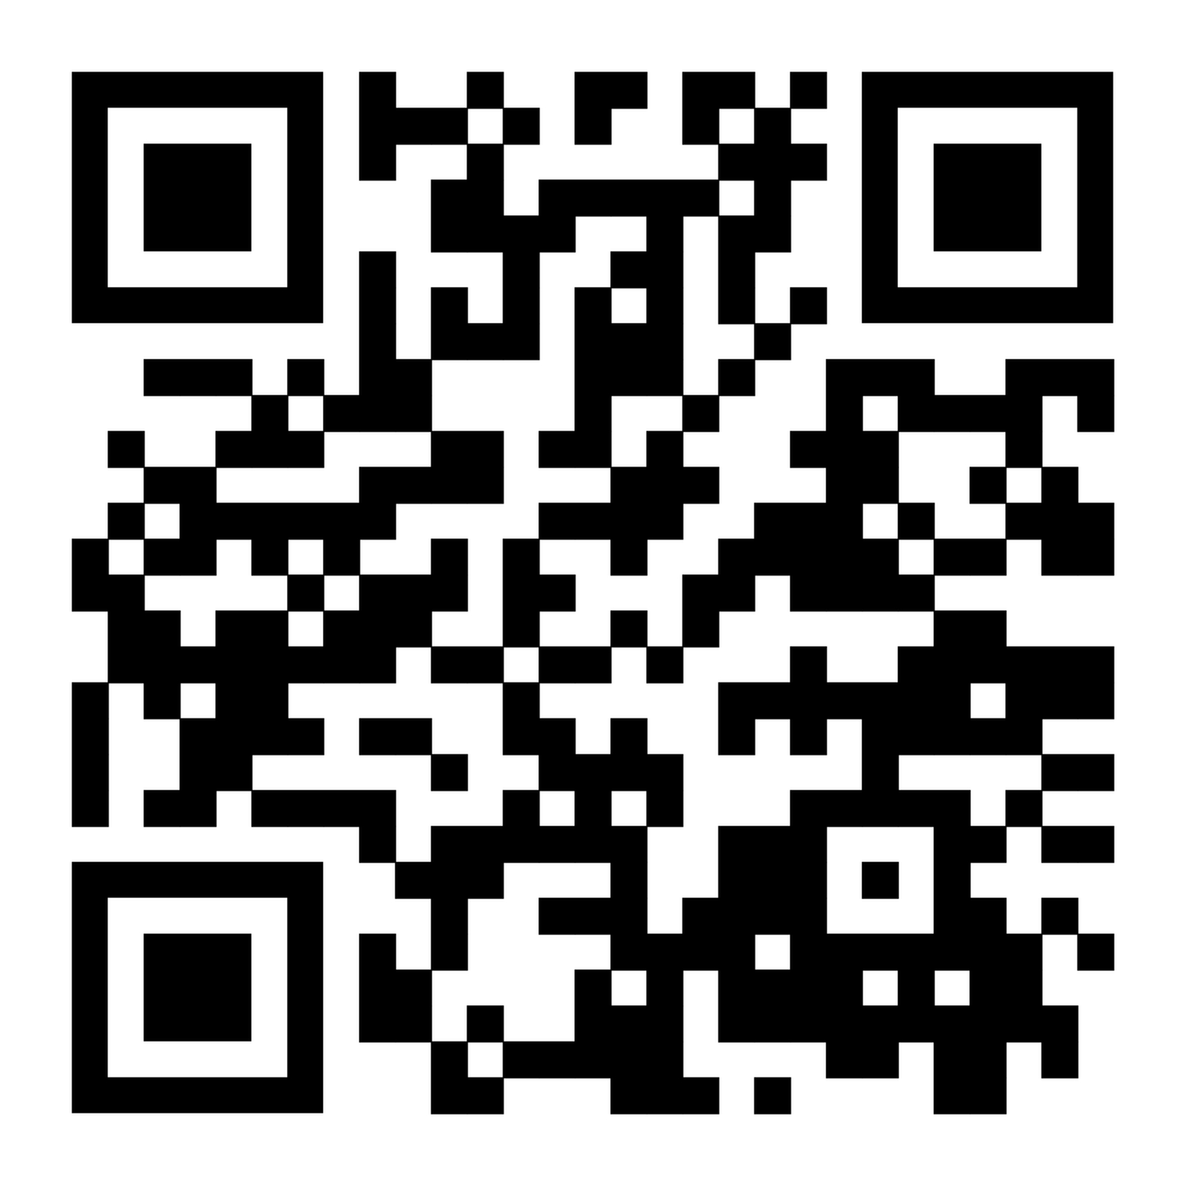
Equitech Growth Fund: Webinar I
To review our first webinar, scan this QR code :

Slide 17
Equitech Growth Fund: Applicant Data (FY'25-FY'26)
Infrastructure = 23
Workforce Development= 52
Infrastructure = 42
Workforce Development= 51
Total Funding Request (FY'25): $31,828,585
Total Funding Request (FY'26): $41,400,636
Notes:
Total funding requests vs received
Nearly double the amount of infrastructure applications received in the second round

Slide 18
Equitech Growth Fund: Past Awardees (FY’25)
Awardee Name | Project & Industry Type | Mission
Clym Environmental Services, LLC Alleghany County | Infrastructure Environmental and Energy Technology | Establish a sustainable medical waste management facility for ozone treatment.
Early Charm Ventures, LLC Baltimore City | Infrastructure Advanced Manufacturing | Equip an advanced materials manufacturing facility available to local manufacturing companies.
Eastern Shore Entrepreneurship Center Talbot County | Infrastructure Advanced Laboratory | Equip an agriculture focused, biotechnology facility with product manufacturing equipment.
Escalate USA, Inc Montgomery County | Workforce Development | Reskill frontline workers for entry-level data analytics, AI and IT jobs.
Health Tech Alley Caroline County | Workforce Development | Lead an employer-focused apprenticeship program in data analytics/AI.
Notes:
High level overview of the awardees from Fiscal Year 2025.

Slide 19
Equitech Growth Fund: Past Awardees (FY’25)
Awardee Name | Project & Industry Type | Mission
KID Museum Montgomery County | Workforce Development STEM Education | Train elementary school teachers on high-quality STEM instruction.
Launchport, LLC (1) Baltimore City | Infrastructure Advanced Manufacturing | Upgrade facility with necessary lab equipment.
Launchport, LLC (2) Baltimore City | Workforce Development Healthcare, Life Science & Bioinformatics | Train and employ operators, assembly technicians to support in-house medical technology startups.
Maryland Association of Community Colleges Howard County | Infrastructure Cybersecurity & IT | Install a cyber range available to community college students across Maryland.
The Coding School Prince George’s County | Workforce Development STEM Education | Pilot a research experience teaching high school and early college students quantum computing and data science skills.

Slide 20
Equitech Growth Fund: Past Awardees (FY’25)
Awardee Name | Project & Industry Type | Mission
TCecure, LLC Prince George’s County | Infrastructure Cybersecurity/IT | Outfit a cybersecurity training clinic preparing market ready certified CMMC Professionals and Assessors.
The Henry M. Jackson Foundation for the Advancement of Military Medicine, Inc. Montgomery County | Infrastructure Advanced Laboratory | Build an incubator targeting startups licensing and/or developing dual-use medical technologies.
University of Maryland, Hagerstown Washington County | Workforce Development STEM Education | Develop an applied computer science lab for community college and high schoolers.
Worksource Montgomery Montgomery County | Workforce Development Healthcare, Life Science & Bioinformatics | Equip entry-level job seekers with skills required for the life science industry.

Slide 21
Equitech Growth Fund: Past Awardees (FY’26)
Awardee Name | Project & Industry Type | Mission
BioBuzz Baltimore City | Workforce Development Healthcare, Life Science and Bioinformatics | Expand a curated, tech-enabled ecosystem platform that targets life science workers and employers.
Energetics Technology Center Prince George’s County | Workforce Development STEAM Education | Train high school educators and underserved students on cybersecurity and AI.
Rise Therapeutics Montgomery County | Infrastructure Healthcare, Life Science and Bioinformatics | Complete modifications to GMP-compliant production facility, scaling microbiome drug manufacturing.
Xcellon Biologics Montgomery County | Infrastructure Advanced Laboratory | Establish state’s first GMP-compliant bioconjugation training facility, scaling advanced biologics manufacturing.
Brightwave, LLC Harford County | Infrastructure Advanced Manufacturing | Establish Maryland's first commercial-scale algae production facility.

Slide 22
Equitech Growth Fund: Past Awardees (FY’26)
Awardee Name | Project & Industry Type | Mission
Consult Lemonade Howard County | Workforce Development Cybersecurity/IT | Provide cybersecurity, cloud engineering and data analytics training to local residents.
Code in the Schools Baltimore City | Workforce Development STEAM Education | Prepare youth and young adult for data-driven roles, with an emphasis on local employer engagement.
Maryland Center for Construction, Education and Innovation Baltimore City | Workforce Development Advanced Manufacturing | Train entry-level construction workers in STEM-enabled construction technology and digital skills.
Salisbury University Wicomico University | Workforce Development Entrepreneur Development | Accelerate commercialization activity across Eastern Shore through academic- industry partnerships and entrepreneurial training.

Slide 23
Equitech Growth Fund: General Tips for Strong Proposal Writing
Start with SMART
  Specific, Measurable, Achievable, Relevant and Time-bound
Leverage relevant data sources to show existing need or potential ecosystem impact
  Wage data, local employment levels, future sector job growth in Maryland
Clarify the organization’s competitive advantage
  Strategic location, traction, high-value partnerships, employer engagement, depth vs. breadth
Demonstrate intentional collaboration with target populations
  Clear access pipelines, strong community buy-in through well-crafted letters of support/ commitment
Do not start at the last minute
  Avoid careless use of AI-assisted writing tools

Slide 24
Equitech Growth Fund: Evaluation Criteria
Alignment with EGF Goals
  Does the project clearly address one or more priority workforce need?
  Are the connections between the project and EGF strategic priorities explicitly articulated?
Project Viability and Feasibility
  Does the organization demonstrate sufficient resources to execute this project?
  Are the project milestones specific and achievable within the proposed timeline?
  Is the budget well-justified, and appropriate for the project scope?
Economic Impact and Job Creation
  Are job creation projections specific and well-supported with evidence?
  How significant is the direct impact, relative to funding requested?

Slide 25
Equitech Growth Fund: Evaluation Criteria
Capacity to Leverage Matching Funds
  What is the cash match ratio and how reliable will these use of funds be?
Community Engagement & Inclusivity
  What suggests genuine community partnerships and effective outreach?
  How well does the project address barriers that prevent underserved populations from participating?
Metrics and Impact Measurement
  Is there a clear and realistic data collection methodology and analysis plan?
  How well do the metrics connect to the project's stated objectives and expected outcomes?

Slide 26
Equitech Growth Fund: Industry-Specific Considerations
Industry | Considerations
Advanced Manufacturing | What gap is addressed in Maryland’s manufacturing capacity at a statewide or local level? How does this accelerate commercial potential for the applicant and other manufacturing companies? What are the associated positive downstream effects (i.e. supplier and logistics)?
Advanced Technology | How does the project include federal, state, academic or industry partner buy-in? How does the research and development (R&D) contribute to Maryland’s competitiveness in emerging technology industries?
AR/VR Learning Facilities and Modules | What unique benefits does the AR/VR learning facility pose over traditional learning methods? Why is this the best learning modality for the applied industry of choice?
Advanced Laboratory | How large is the potential direct/indirect impact on local startup commercialization? (i.e. revenues, patents, licenses, product scaling or spin outs) Why should we fund a facility at this location? (i.e. local assets, market demand)

Slide 27
Equitech Growth Fund: Industry-Specific Considerations
Industry | Considerations
Expansion of STEAM Education | Who are the target school or higher-education partners, and why? How does experiential learning prepare students for jobs of the future?
Entrepreneur Development | How does the applicant prioritize and tailor support for underrepresented founders? How does the applicant distinguish between direct employment and downstream job creation? How does the education or training prepare startup founders for existing market need? How does the applicant integrate investor, corporate or industry collaboration?
Cybersecurity/IT Workforce Development | What underrepresented populations does the applicant prioritize, and how do they reach them? What certifications and/or skills training are beneficiaries receiving and why? How are existing local/statewide workforce pipelines leveraged?

Slide 28
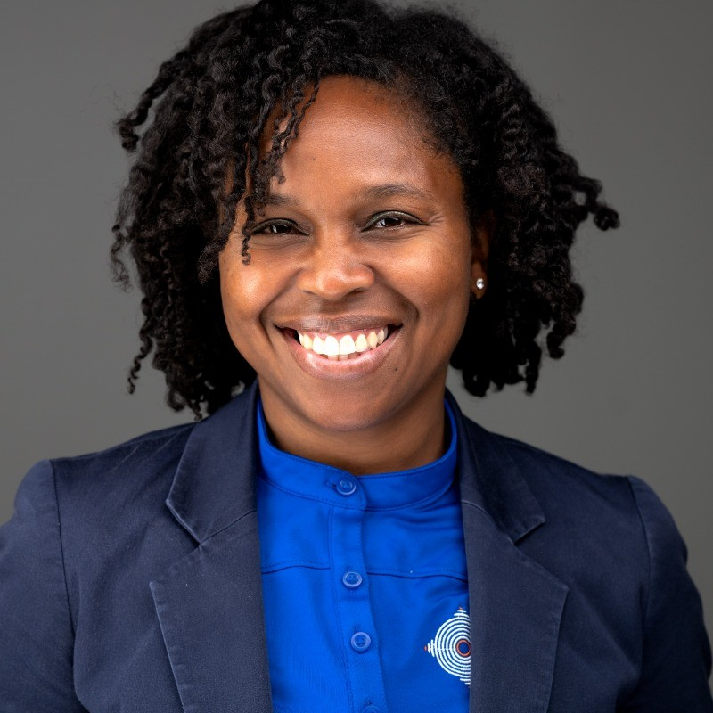
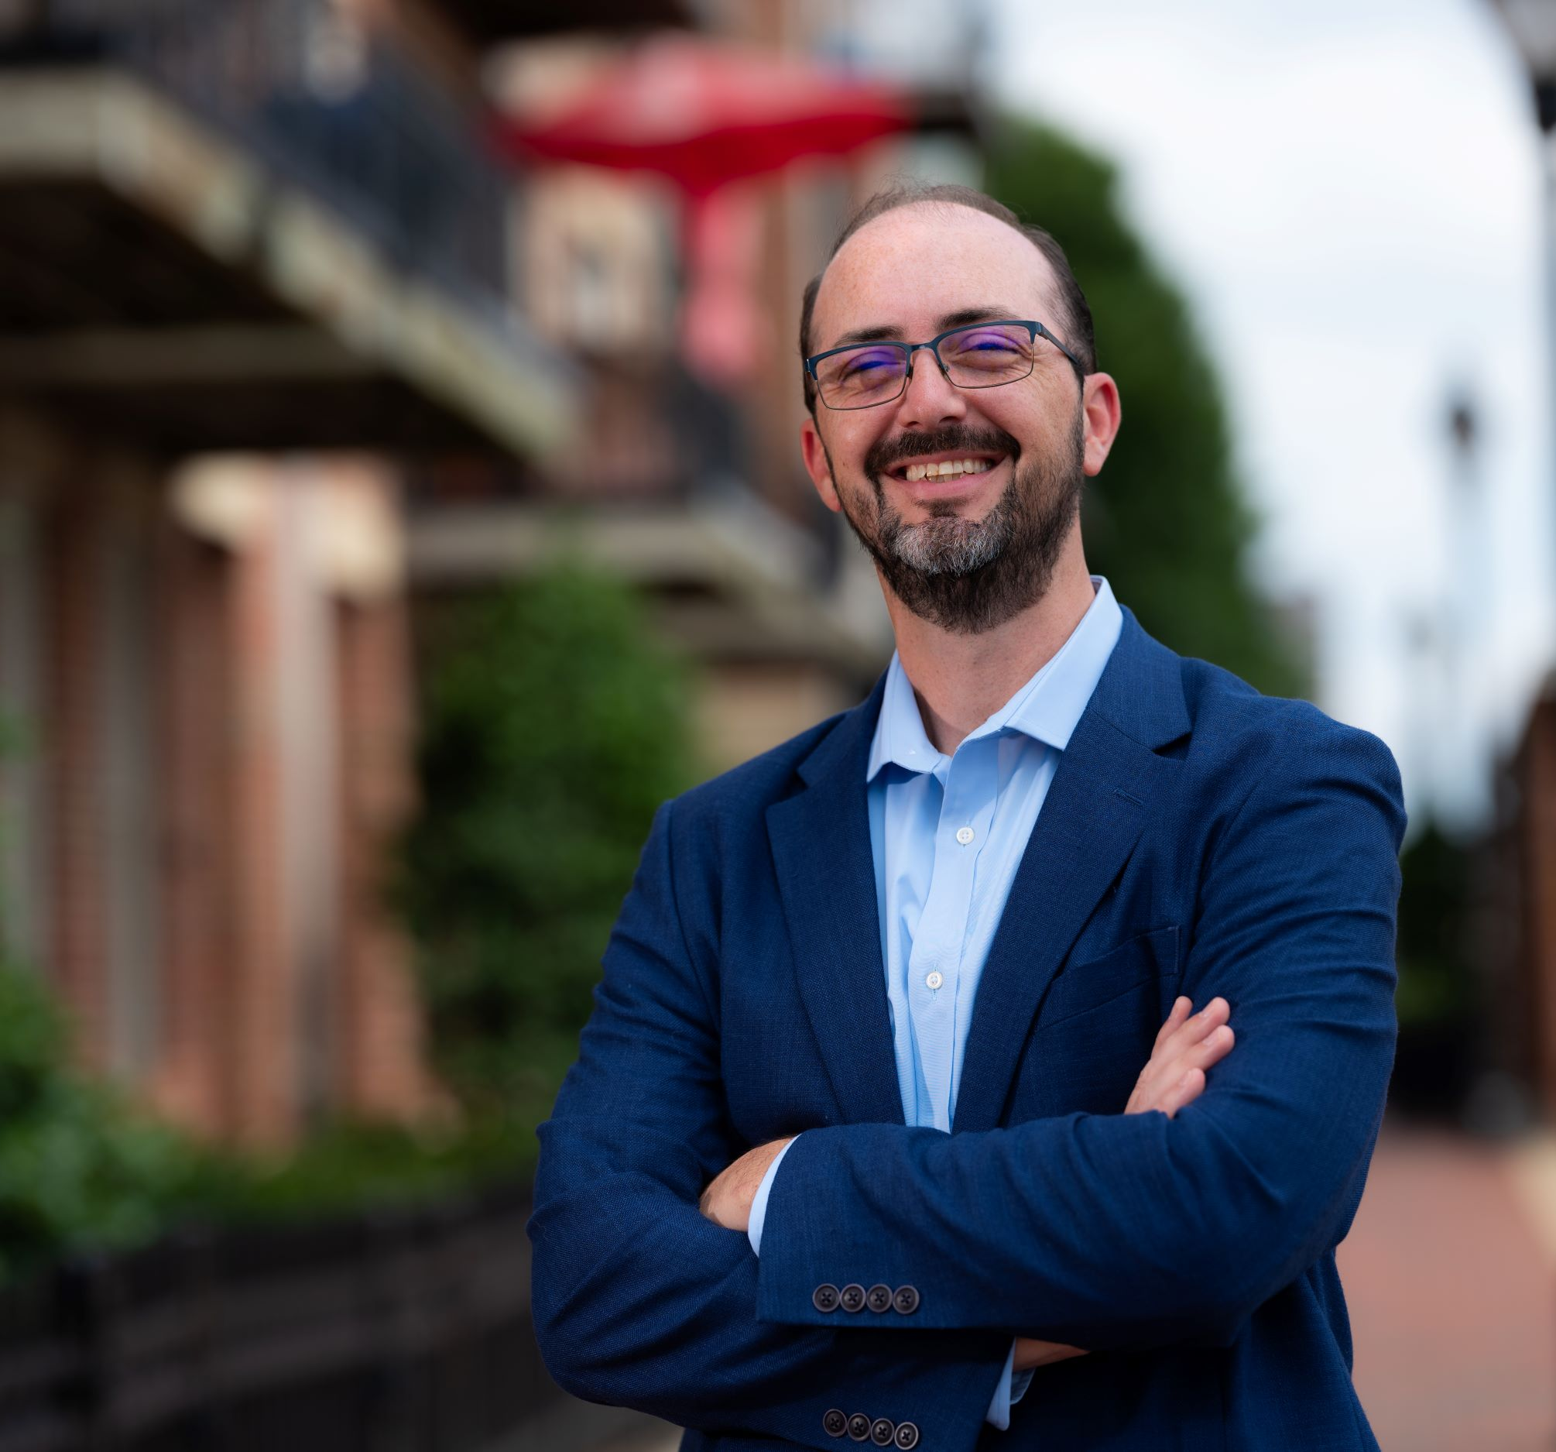
Equitech Growth Fund: Awardees Q&A
Tina Williams Koroma
TCecure, LLC | Founder
EGF Awardee FY’25
Chris Frew
BioBuzz Networks, Inc. | Founder
EGF Awardee FY’26

Slide 29
Questions?

Slide 30
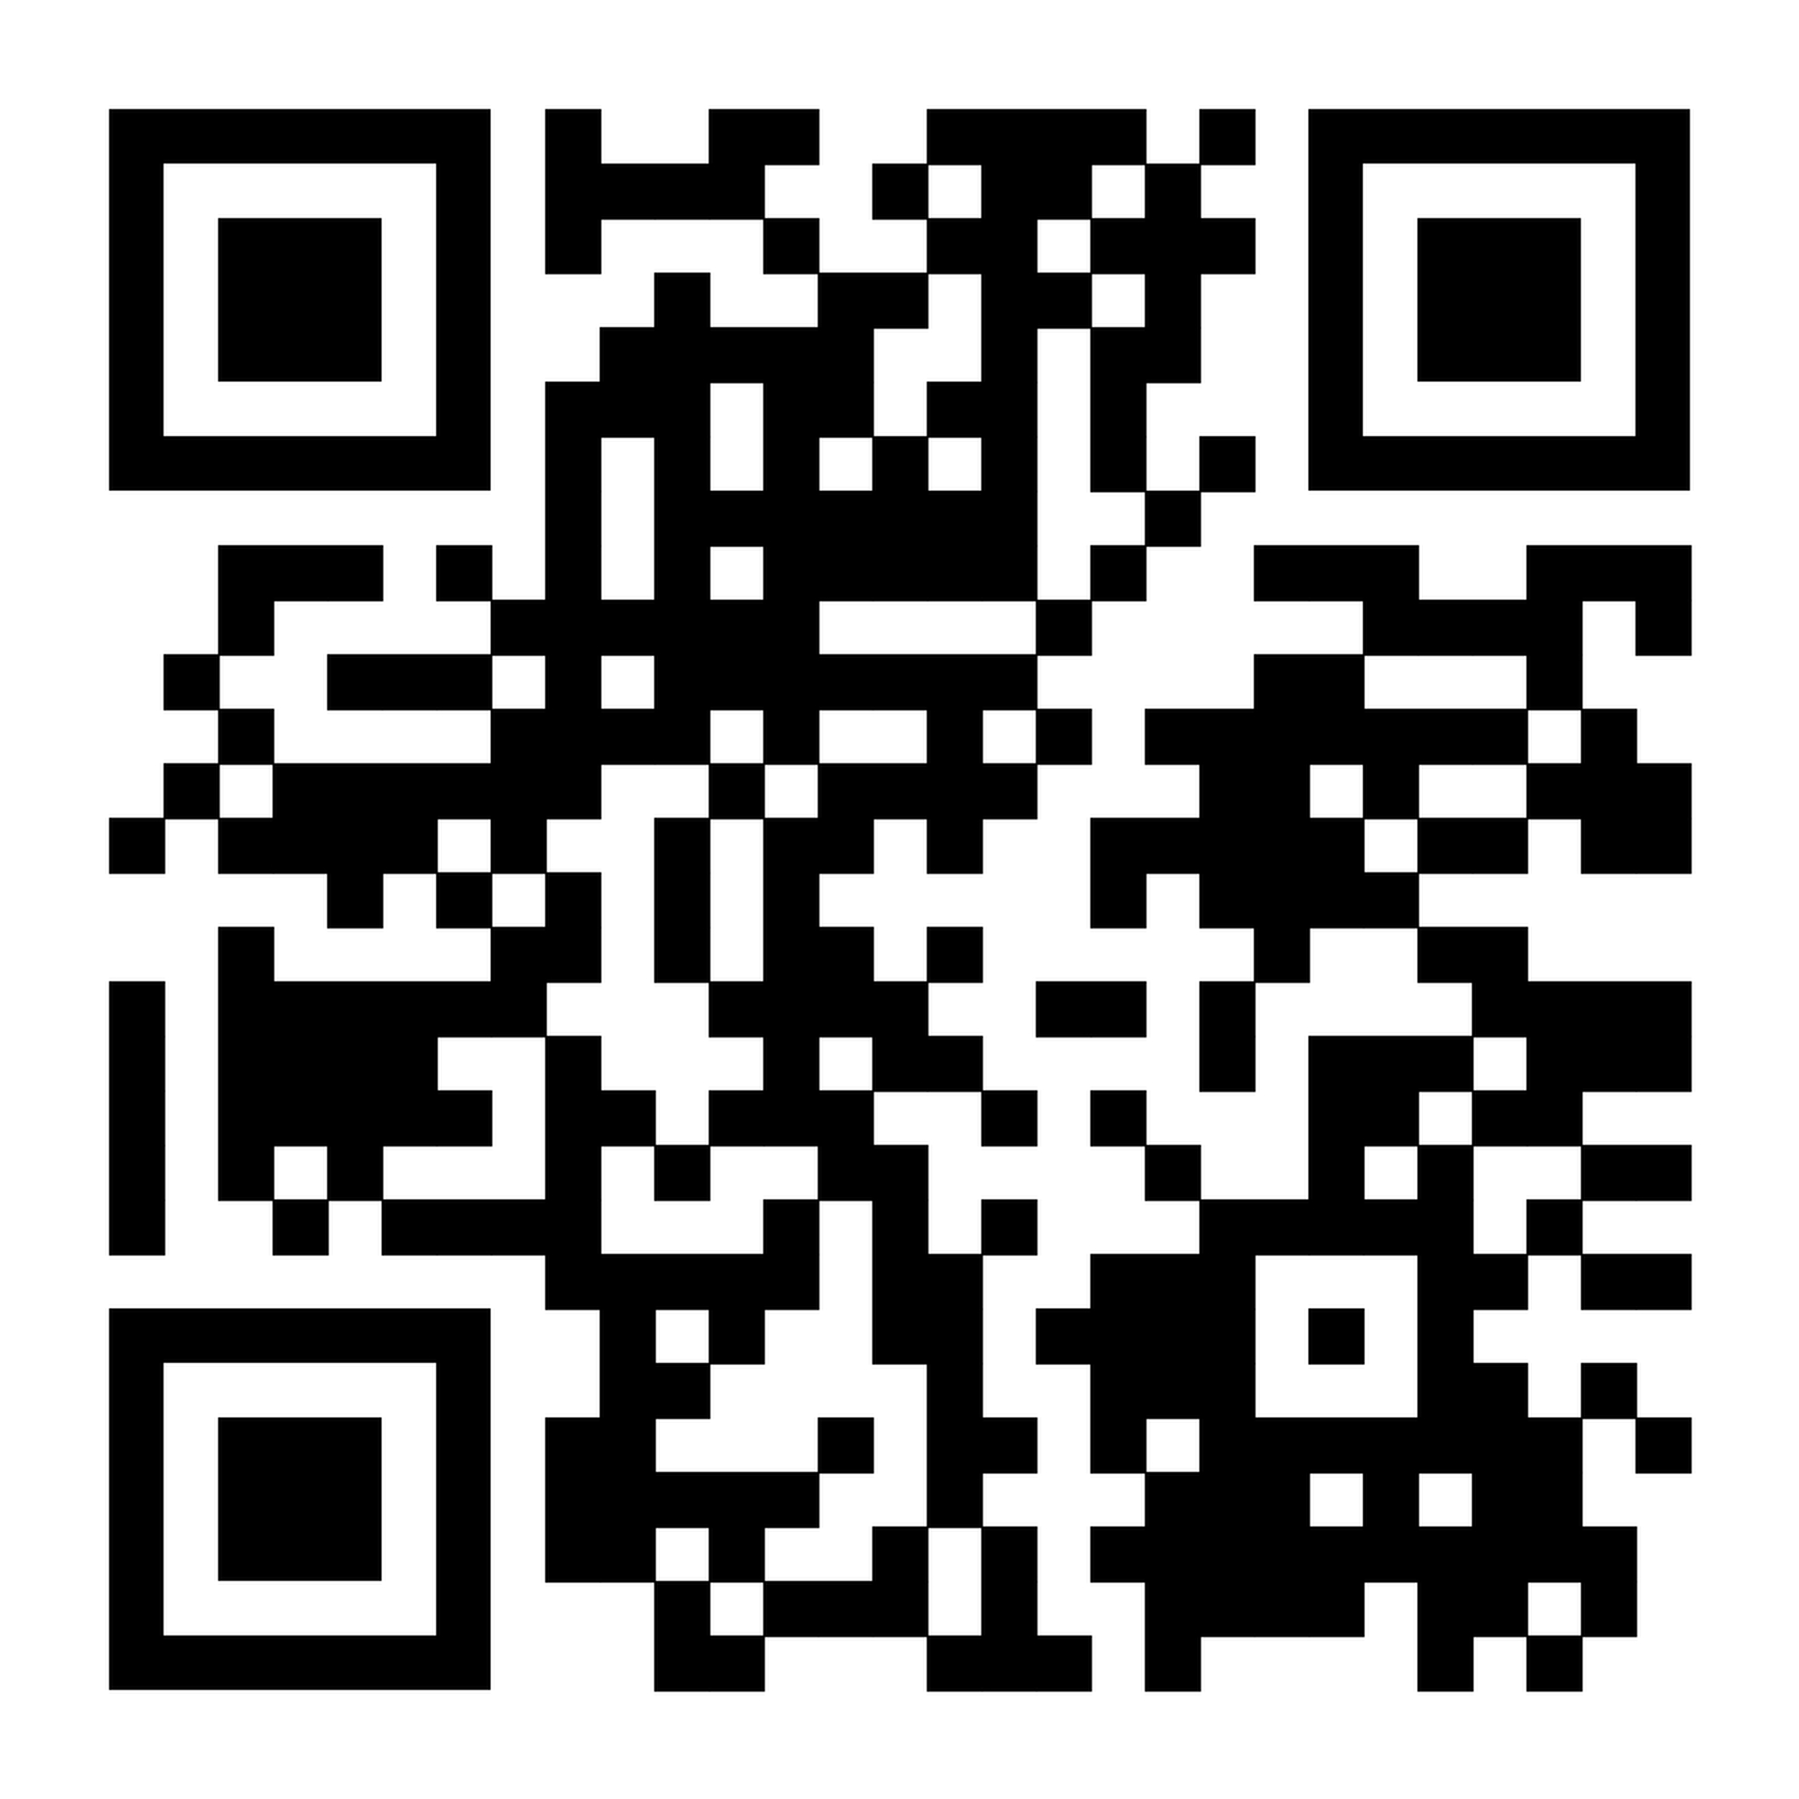
Equitech Growth Fund: Office Hour | July 23 @ 11 AM
To register, scan this QR code :

Slide 31


Sephora Saint-Armand
Ecosystem and Equitech Manager
equitechgrowth@tedcomd.com

